Slide 1

Implementation of the Common Regional Market Action Plan 2025–2028 (CRM 2.0)
From Regional Commitments to Results in Practice
Analytical Report
Dr. Besim Mustafa, CRM Expert
September 2026
CRM 2.0

Slide 2
EXECUTIVE SUMMARY
CRM 2.0 is advancing, but business benefits remain uneven
REGIONAL PROGRESS
IMPLEMENTATION GAP
6
Priority areas showing implementation progress
UNEVEN
day-to-day benefits for businesses
Common frameworks, systems and implementation arrangements are strengthening across the region.
Delays and excessive paperwork continue to affect cross-border operations.
Selected measures are moving into operational use and generating practical benefits.
Recognition barriers and limited interoperability persist across the regional market.
CRM 2.0 is creating a stronger foundation for regional and EU Single Market integration.
Regional progress has not yet translated consistently into lower costs and simpler procedures.
NEXT PHASE
Focus on consistent domestic implementation, stronger business uptake and measurable results.
WB6CIF can connect business evidence with regional implementation dialogue and sustained institutional follow-up.

Slide 3
INTRODUCTION
Why CRM 2.0 matters
REGIONAL INTEGRATION
BUSINESS RELEVANCE
6
economies building a more connected and competitive regional market
FEWER
barriers, lower costs and stronger market access
Easier movement of goods, services, capital and people across the Western Balkans.
Success means simpler, faster and more predictable cross-border operations.
Progressive alignment with EU rules, standards and market conditions.
Businesses should gain stronger access to regional and European opportunities.
A practical bridge towards participation in the EU Single Market.
The assessment tests whether formal commitments are producing practical improvements.
WB6CIF ROLE
WB6CIF connects implementation monitoring with the practical experience of the regional business community.

Slide 4
PURPOSE AND SCOPE
Assessing the transition from commitment to results
ASSESSMENT FOCUS
SCOPE AND BOUNDARIES
RESULTS
beyond formal adoption and institutional reporting
REGIONAL
perspective without ranking individual economies
Assess CRM 2.0 implementation across the Western Balkans from a business perspective.
Focus on costs, processing time, administrative burdens and market access.
Examine progress from formal commitments through operational implementation.
Highlight implications for competitiveness and integration with European markets.
Identify where tangible results are visible and where implementation gaps remain.
Provide a selective assessment rather than a review of every CRM action.
CORE QUESTION
Are CRM commitments making cross-border business easier, faster and less costly in practice?

Slide 5
REGIONAL AND EU INTEGRATION CONTEXT
CRM 2.0 forms part of a wider European economic transformation
WIDER FRAMEWORK
BERLIN PROCESS
CRM 2.0
EU GROWTH PLAN
EU ACCESSION AND SINGLE MARKET
27% / 41%
~40%
€87.7 bn
GDP per capita relative to the EU average
2003 / 2024
Labour productivity
relative to the EU level
EU–Western Balkans
trade in goods, 2025
THE REMAINING GAP
INVESTMENT OPPORTUNITY
Convergence remains slow, with persistent constraints in skills, infrastructure, digitalisation and productive investment.
A more integrated and predictable market can strengthen competitiveness and help firms enter higher-value European supply chains.
KEY MESSAGE
The region is increasingly connected to the EU. The depth and quality of integration must now improve to deliver stronger investment and business opportunities.

Slide 6
ASSESSMENT APPROACH
Tracking progress from commitment to results in practice
Objective: assess how far selected CRM 2.0 commitments have progressed towards operational implementation and tangible results.
IMPLEMENTATION CONTINUUM
1
2
3
4
FORMAL
COMMITMENT
REGULATORY
IMPLEMENTATION
OPERATIONAL
APPLICATION
RESULTS
IN PRACTICE
EVIDENCE BASE
ASSESSMENT BOUNDARIES
Institutional reporting and operational evidence are assessed alongside independent analysis and private-sector experience. The focus remains regional, selective and business-oriented.
The assessment does not rank economies, review every CRM action or attribute wider economic developments directly to CRM. It identifies progress, gaps and future milestones.
CORE QUESTION
How far have agreed measures moved into operational use, and are businesses experiencing observable benefits?

Slide 7
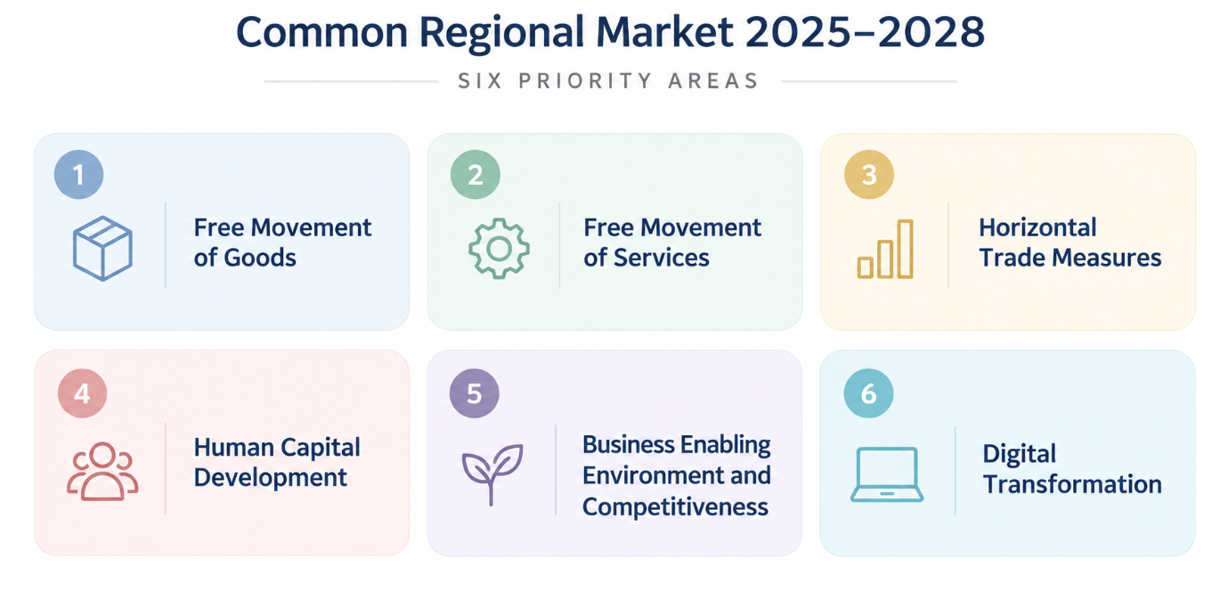

Slide 8
EVIDENCE BASE AND STAKEHOLDER INPUT
Three perspectives test whether formal progress reaches businesses
No single source can adequately capture the full implementation of CRM 2.0.
1
2
3
INSTITUTIONAL
EVIDENCE
OPERATIONAL AND
INDEPENDENT EVIDENCE
STAKEHOLDER
EXPERIENCE
CRM frameworks, implementation decisions and reporting from RCC, CEFTA, the Transport Community, the European Commission and national authorities.
Utilisation data, measurable results and independent analysis, including evidence from the World Bank and OECD.
Input from businesses, Chamber National Coordinators, Government Focal Points and the six WB6CIF thematic groups.
ANALYTICAL VALUE
Triangulation distinguishes formal adoption from operational implementation and actual business experience.
It reveals where regional measures are delivering results and where progress has not yet reached businesses.

Slide 9
BUSINESS SURVEY PROFILE
Respondents bring direct experience of regional business activity
CROSS-BORDER EXPOSURE
RESPONDENT DIVERSITY
3 OUT OF 4
6
Western Balkan economies represented
Companies differ in size, sector and operational profile, providing a broad range of business perspectives.
respondents engage in regional or cross-border business activity
STRONG REPRESENTATION
Their responses reflect direct experience with the procedures and barriers that CRM 2.0 seeks to improve.
Manufacturing, logistics, trade and agri-food
OTHER SECTORS
Services, ICT, energy, finance and professional services
INTERPRETATION
The findings provide indicative evidence of business experience. They are not statistically representative estimates or a basis for ranking economies.

Slide 10
CRM 2.0 IMPLEMENTATION ASSESSMENT
Free Movement of Goods
IMPLEMENTATION PROGRESS
BUSINESS EXPERIENCE
TRACES NT supports electronic exchange of veterinary certificates across all CEFTA Parties.
66.7%
report procedural delays
SEED notifications launched for phytosanitary measures.
55.6%
report excessive paperwork
Regional AEO framework established with 150+ authorised operators.
53.7%
report limited digitalisation
Customs Risk Management Strategy 2025–2028 adopted.
PERSISTENT FRICTIONS
Recognition of conformity-assessment results is progressing.
Recognition problems, repeated testing and inconsistent controls continue to affect firms.
ASSESSMENT: INTERMEDIATE IMPLEMENTATION
Regional systems are advancing, but consistent application and practical business benefits remain uneven.

Slide 11
CRM 2.0 IMPLEMENTATION ASSESSMENT
Free Movement of Services
IMPLEMENTATION PROGRESS
BUSINESS EXPERIENCE
Recognition agreements cover seven professional qualifications across all six economies.
MORE THAN HALF
report limited or no improvement in cross-border services
Regional measures support tourism, e-commerce and parcel delivery.
50.0%
identify different national regulations as a barrier
Digital frameworks cover electronic signatures, seals and trust services.
35.2%
report administrative burdens
SEPA participation is reducing payment costs and processing times in Albania, Montenegro and North Macedonia.
PERSISTENT FRICTION
Recognition of licences and qualifications remains inconsistent.
ASSESSMENT: INTERMEDIATE IMPLEMENTATION
Regional frameworks are advancing, but simpler, predictable and consistently applied procedures remain the priority.

Slide 12
3.3 HORIZONTAL TRADE MEASURES
Trade facilitation is expanding, but border benefits remain uneven
IMPLEMENTATION PROGRESS
BUSINESS EXPERIENCE
16
Green Lanes project fiches connect intra-CEFTA and EU border cooperation
50%
report limited or no progress in reducing border waiting times
SEED+ is expanding electronic pre-arrival data exchange with neighbouring EU Member States.
66.7%
report delays across the trade process
Coordinated risk management supports earlier analysis and more targeted border controls.
55.6%
report excessive paperwork
Additional Protocol 7 strengthens consultation, mediation and dispute-settlement procedures.
53.7%
report limited digitalisation
KEY MESSAGE
Green Lanes, SEED+ and risk-based cooperation are becoming operational. Consistent coordination is now essential to reduce waiting times and make trade more predictable.

Slide 13
3.4 HUMAN CAPITAL DEVELOPMENT
Skills frameworks are advancing, but regional mobility remains constrained
IMPLEMENTATION PROGRESS
BUSINESS EXPERIENCE
12
10
12
occupational standards,
qualification standards
and curricula developed
33%
have basic digital skills, compared with 56% in the EU
Regional standards are being translated into national qualifications and VET curricula.
>190k
potential worker shortfall within five years
Business input is improving alignment between vocational education and labour-market needs.
Recognition of qualifications, licences and certificates remains inconsistent.
A regional framework now supports the coordination and portability of social-security rights.
Fragmented procedures restrict access to the wider regional talent pool.
KEY MESSAGE
Implementation is moving from regional frameworks towards early operational results. Stronger recognition and mobility arrangements are needed to make skills usable across the WB6.

Slide 14
3.5 BUSINESS ENABLING ENVIRONMENT AND COMPETITIVENESS
Regional participation is growing faster than business competitiveness
IMPLEMENTATION PROGRESS
BUSINESS EXPERIENCE
€87.7B
EU–Western Balkans trade in 2025, up 5.2% from 2024
4.1%
FDI as a share of regional GDP, down from 5.4%
A regional package supports sustainable investment and investment facilitation.
Regional activity is expanding, but delivery, cost and time improvements remain modest.
The WB6 Green Bond Standard establishes common requirements for green finance.
SMEs continue to face limited access to finance and business support.
Policy is shifting towards investment quality and stronger links between foreign investors and local firms.
Participation in regional and European value chains remains insufficient.
KEY MESSAGE
Regional market participation is advancing faster than competitiveness gains. The next priority is greater efficiency, stronger access to finance and deeper value-chain participation.

Slide 15
3.6 DIGITAL TRANSFORMATION
Digital foundations are advancing, but cross-border use remains limited
IMPLEMENTATION PROGRESS
BUSINESS EXPERIENCE
59%
of WB6 SMEs have reached at least basic digital intensity
7 in 10
report limited or no progress in cross-border digital transactions
Regional frameworks now cover electronic signatures, trust services and digital identity.
2 in 3
report limited progress in digital document exchange
EU roaming integration and participation in EU digital programmes are advancing.
69%
report limited progress in cross-border online sales
24% of SMEs sell online, while stronger cybersecurity cooperation supports secure integration.
Delivery costs, returns, long delivery times and regulatory requirements remain barriers.
KEY MESSAGE
National digitalisation is advancing faster than regional interoperability. The priority is to make digital systems, identities and documents work consistently across WB6 borders.

Slide 16
CRM RESULTS IN PRACTICE
Early operational results show what CRM 2.0 can deliver
Evidence of wider reductions in costs and processing times remains limited
OPERATIONAL RESULTS
DIRECT BUSINESS BENEFIT
01
TRACES NT
Electronic exchange of agreed veterinary certificates across CEFTA Parties
SEPA
02
SEED+
Pre-arrival customs information exchanged electronically, including with EU neighbours
Faster and less costly euro payments
03
150+ AEOs
Regional trusted-trader framework has an expanding operational base
Operational in
3 economies
04
12 / 10 / 12
Occupational standards, qualification standards and curricula developed through EQET SEE
Albania, Montenegro and North Macedonia
KEY MESSAGE
CRM delivers when commitments reach operational implementation. The next test is whether these gains become consistent across the regional market.
Sources: European Payments Council and World Bank; CEFTA; ERI SEE / EQET SEE

Slide 17
BUSINESS EXPERIENCE
Regional participation is growing, but daily business conditions remain difficult
DAY-TO-DAY EXPERIENCE
REGIONAL PARTICIPATION
3 OUT OF 4
50%
>50%
7 IN 10
Border waiting times
Cross-border services
Digital transactions
respondents engage in regional or cross-border business activity
report limited or no progress
report limited or no improvement
report limited or no progress
RECURRING BARRIERS
Businesses are already using the regional market
66.7%
55.6%
53.7%
Different requirements and recognition problems
Delays
Paperwork
Limited digitalisation
KEY MESSAGE
Businesses are active across the region, but the operating environment does not yet function as one integrated market.
Source: WB6CIF business survey, 2026. Findings are indicative and are not statistically representative of the regional private sector.

Slide 18
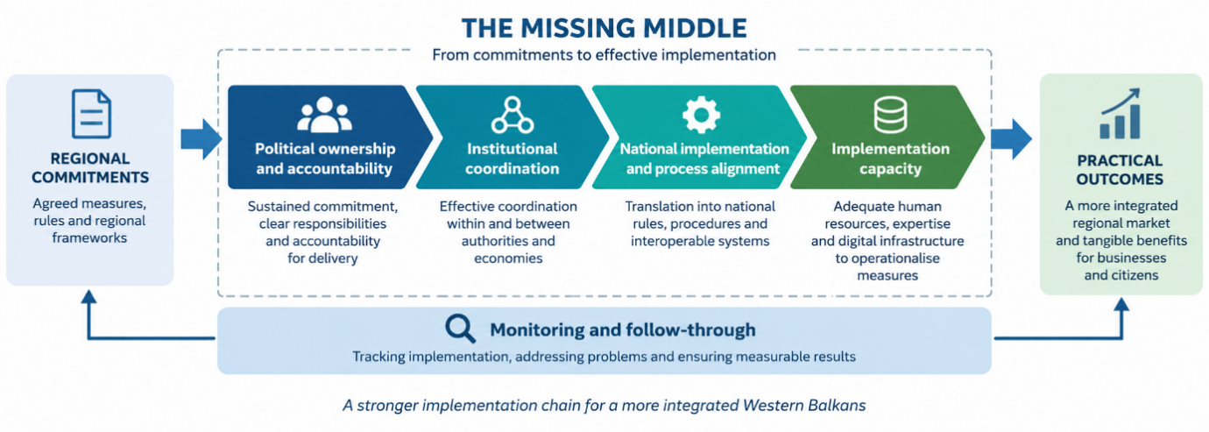
Cross-Cutting Implementation Challenges: The Missing Middle

Slide 19
OVERALL ASSESSMENT OF CRM 2.0
Stronger foundations, but market-wide results remain incomplete
WHAT HAS BEEN ACHIEVED
WHAT REMAINS INCOMPLETE
STRONG BASE
Regional frameworks, systems and implementation arrangements
UNEVEN
application across economies, institutions and priority areas
Selected measures have moved from formal commitments into operational use.
Regional commitments do not yet function consistently across borders.
Practical benefits are emerging in payments, customs cooperation and digital exchange.
Businesses still face delays, administrative burdens and recognition barriers.
CRM 2.0 has created a stronger foundation for regional economic integration.
Interoperability and practical business benefits remain only partially realised.
KEY MESSAGE
The future benchmark is practical performance: simpler procedures, effective recognition, shorter processing times, lower costs and reliable cross-border functionality.

Slide 20
STRATEGIC CONCLUSIONS AND WAY FORWARD
Four priorities for the next phase of CRM 2.0
DELIVERY AND PROCESS
UPTAKE AND RESULTS
01
Strengthen national delivery
03
Support business uptake
Translate regional commitments into clear national rules, assign responsibilities and ensure consistent application by all responsible authorities.
Give SMEs accessible guidance and practical support to use market access arrangements, finance, digital services and value-chain opportunities.
02
Improve the complete cross-border process
04
Monitor practical results regularly
Coordinate the full transaction so faster procedures are not undermined by repeated inspections, unrecognised documents, payment difficulties or delivery delays.
Measure costs, processing times, reliability and ease of use. Simplify mechanisms that remain costly, complicated or time-consuming for businesses.
KEY MESSAGE
The real test of CRM 2.0 is whether businesses can use regional arrangements easily and experience tangible benefits in their daily operations.

Slide 21
STRATEGIC CONCLUSIONS AND WAY FORWARD
WB6CIF gives regional business a trusted voice
The only structured regional platform bringing together the chambers and business communities of all six Western Balkan economies.
ROLE OF WB6CIF
A trusted business partner for governments, regional organisations and European institutions
01
02
03
04
Represent regional business
Provide reliable evidence
Connect business and institutions
Maintain implementation follow-up
Bring together the six chambers and communicate shared private-sector interests.
Document barriers, costs and implementation gaps through direct business experience.
Support trusted dialogue with governments, regional organisations and EU partners.
Track whether agreed measures lead to practical improvements for companies.
FINAL MESSAGE
WB6CIF can help convert regional commitments into consistent cross-border functionality and visible benefits for businesses.

Slide 22
THANK
YOU
Dr. Besim Mustafa
CRM Expert – WB6CIF
Mob
+383 44 149 953
Email
besimmustafa@gmail.com
Implementation of the Common Regional Market Action Plan 2025–2028
From regional commitments to results in practice
Notes:
Closing slide.

