Slide 1


CIF WB6 PROJECT “EU SUPPORT TO THE WB6 CIF FOR THE DEVELOPMENT OF THE COMMON REGION MARKET”
INTRA-REGIONAL TRADE POTENTIALS AND REGIONAL VALUE CHAINS PERSPECTIVES IN THE WESTERN BALKANS REGION
International Institute for Business Analysis - IIBA Skopje
Darko Lazarov
Aleksandar Konatar
1
Notes:
The two objectives are the two halves of the study and of this presentation. The first is answered by the export potential indicator, the second by the 120 regional value chains.

Slide 2
STUDY OBJECTIVES
Two key objectives
01 Trade Potential
Intra-regional trade potential among Western Balkan economies
Trade potential of each WB economy with the EU and global markets
Identification of opportunities for expanded trade and market access
02 Regional Value Chains
Opportunities for development of regional value chains
Identification of sectors with potential for stronger regional production linkages
Opportunities for deeper integration into EU and global value chains
1
Notes:
The two objectives are the two halves of the study and of this presentation. The first is answered by the export potential indicator, the second by the 120 regional value chains.

Slide 3
STRATEGIC ALIGNMENT
Aligned with the Western Balkans’ regional priorities
Strengthening Export Competitiveness
Economic, trade and business cooperation among the economies of the region
Supporting EU Integration
Better positioning of Western Balkan economies within EU value chains
Promoting Regional Economic Development
Development of a functional Common Regional Market
Trade potential → Regional value chains → Regional integration → Export competitiveness
2
Notes:
The bottom bar is the logic of the whole study: measure the potential, find the chains that could carry it, and the integration and competitiveness follow from those two.

Slide 4
METHODOLOGICAL APPROACH
Internationally grounded. Regionally tailored. Data-driven.
Scientific foundation
International Trade Centre (ITC), Geneva
Harvard University – Center for International Development (CID)
Our methodological contribution
Development of own analytical models
Development of dedicated software for estimation
Adaptation to the specific characteristics of Western Balkan economies
Data foundation
UN Comtrade
Eurostat
National statistical offices
World Bank
Other official and international sources
Coverage
5,000+ products at 6-digit HS level
150+ countries
International methodology + own models & software + detailed product- and country-level data
3
Notes:
The middle block is the one to dwell on: the methodology is ITC's and Harvard's, but the models and the software that produce these numbers were built for this study and adapted to six economies whose data are not uniform.

Slide 5
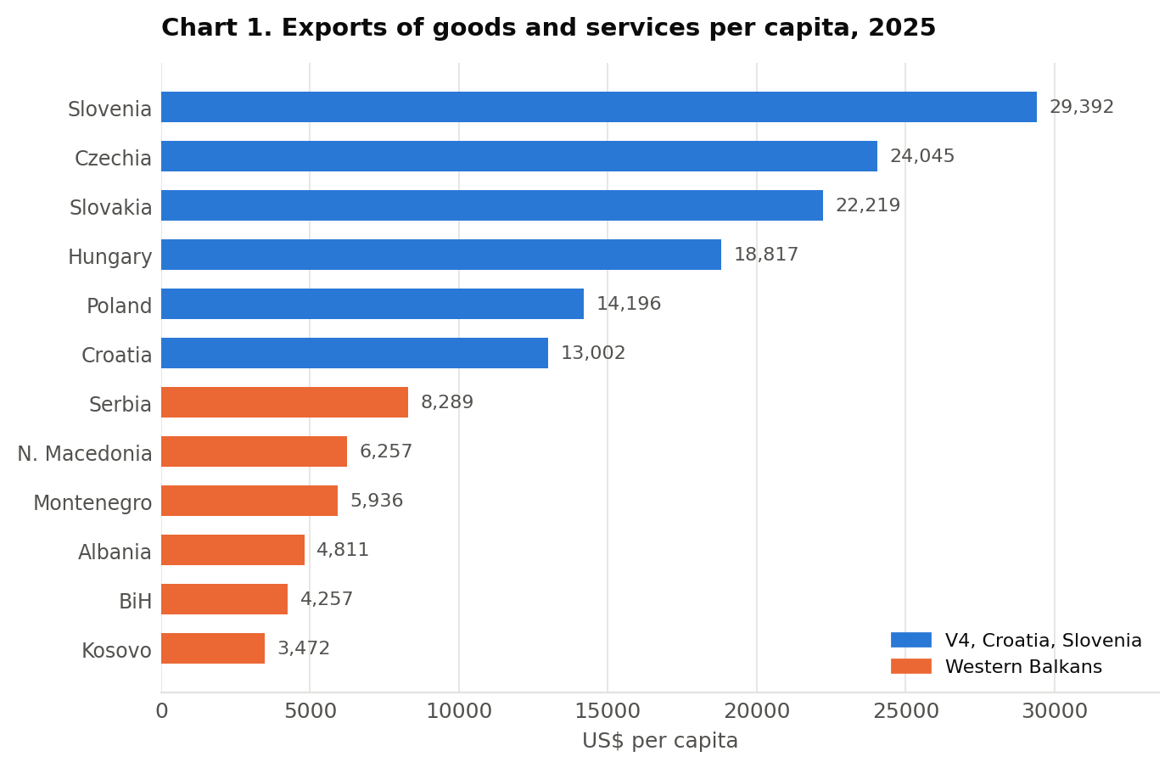
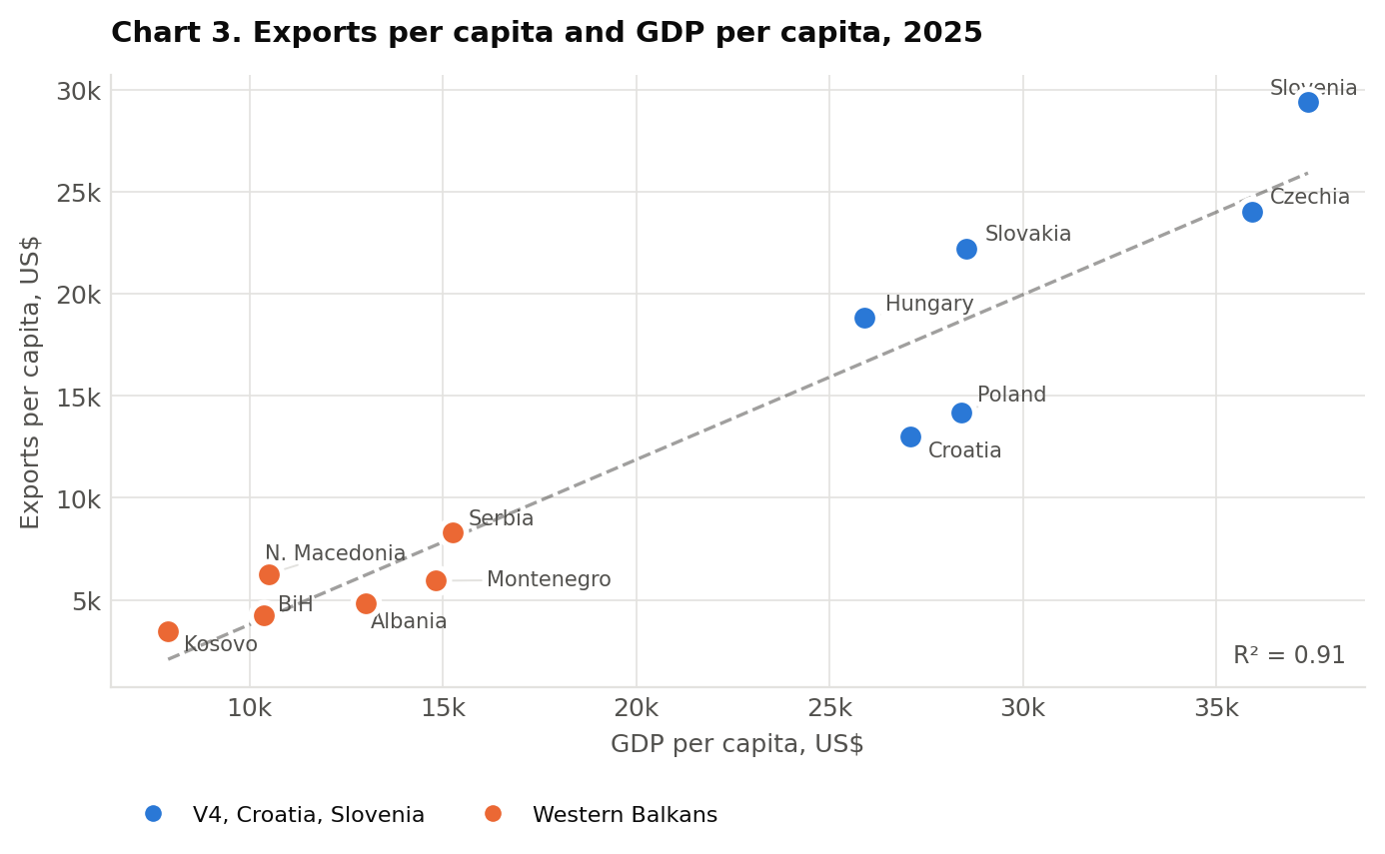
EXPORT PERFORMANCE
Regional export performance
4
Notes:
Two charts, one point. The left one is the raw ranking and it looks like a gulf: Slovenia exports eight times what Kosovo does per head. The right one puts the same numbers against GDP per capita and the relationship is almost mechanical — R² of 0.91. The six are not exporting badly for their income level; they are poorer. That matters for what the rest of the presentation can claim: the room to improve is not in trading more of the same, it is in the composition.

Slide 6
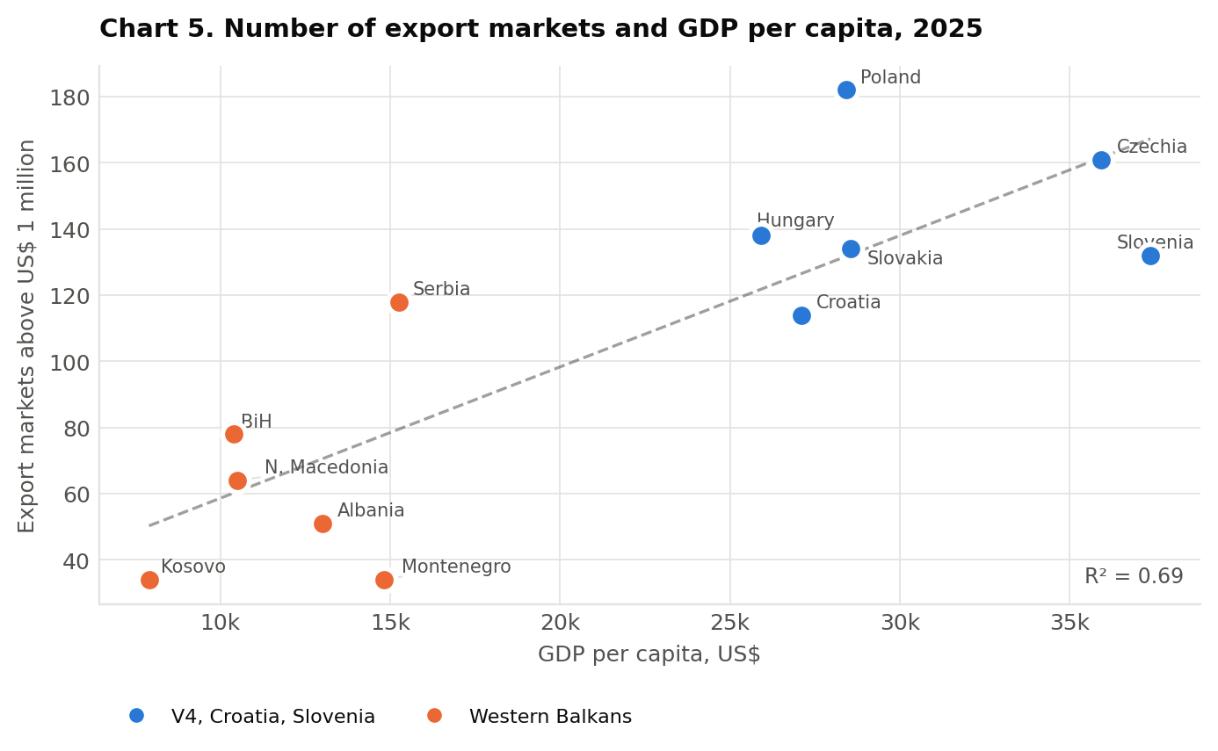
MARKET REACH
Export diversifications-markets
Country | Export markets above US$ 1 million
Poland | 182
Czechia | 161
Hungary | 138
Slovakia | 134
Slovenia | 132
Croatia | 114
Average, V4 + Croatia + Slovenia | 144
Serbia | 118
Bosnia and Herzegovina | 78
North Macedonia | 64
Albania | 51
Montenegro | 34
Kosovo | 34
Average, Western Balkans | 63
5
Notes:
The threshold matters: a market is counted only if it takes at least a million dollars of goods, so this is reach that means something commercially, not a list of countries that once received a shipment.
Serbia reaches almost as many markets as Croatia. Below Serbia the drop is steep — Bosnia and Herzegovina 78, North Macedonia 64, and then three economies in the thirties. The chart on the right shows this is only partly an income story: the six sit below the fitted line more often than above it, which means they reach fewer markets than their income would predict.

Slide 7
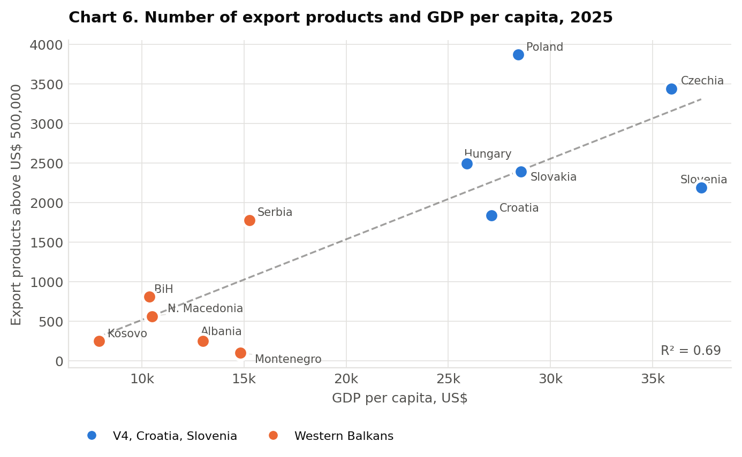
PRODUCT BREADTH
Export diversifications-products
Country | Export products above US$ 500,000
Poland | 3,868
Czechia | 3,442
Hungary | 2,494
Slovakia | 2,388
Slovenia | 2,189
Croatia | 1,835
Average, V4 + Croatia + Slovenia | 2,703
Serbia | 1,775
Bosnia and Herzegovina | 812
North Macedonia | 559
Albania | 250
Kosovo | 245
Montenegro | 99
Average, Western Balkans | 623
6
Notes:
This is the narrowest measure in the section and the one that carries furthest into the rest of the study. A country that exports 99 products competitively has very little to diversify from — which is exactly what the product diversification indicator will show later for Montenegro and Albania, where most of the potential lies in products they do not export at all.
Serbia's 1,775 is close to Croatia's 1,835. On this measure the region is not one thing: Serbia belongs with the comparators, the other five do not.

Slide 8
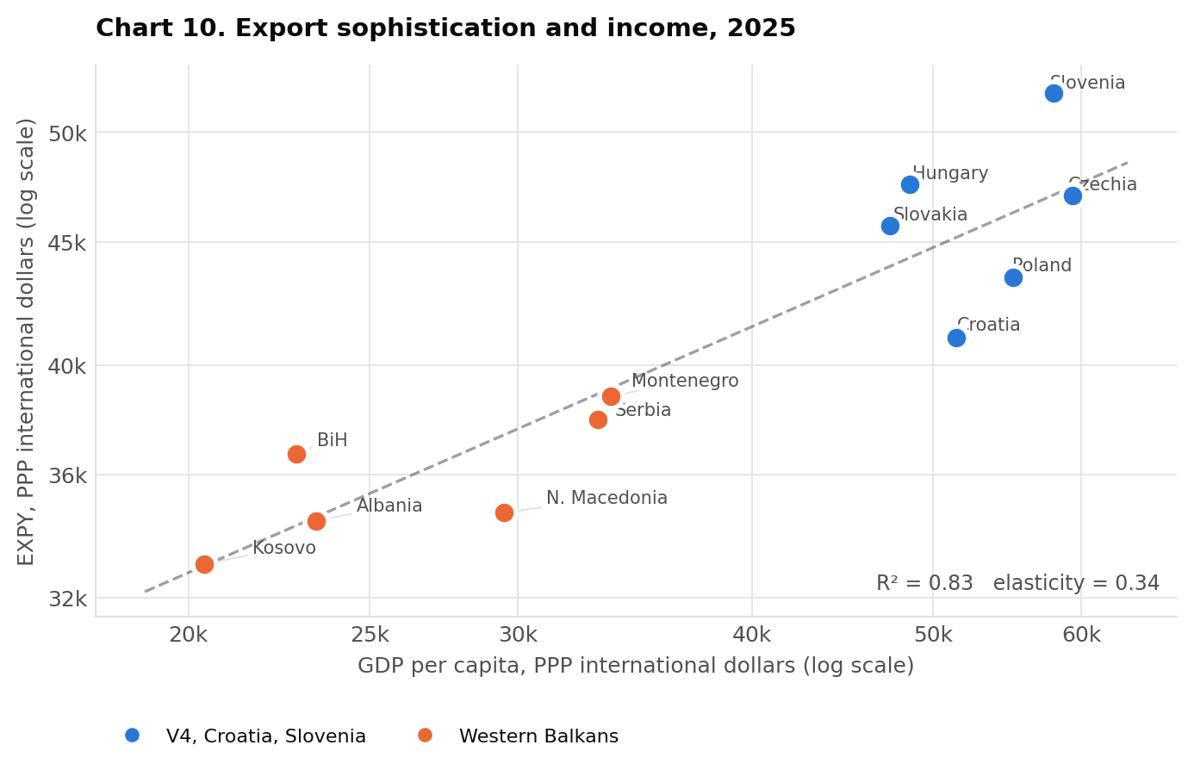
EXPORT SOPHISTICATION
Export sophistication and standardness/ubiquity
Country | GDP per capita, PPP $ | EXPY, PPP $ | EXPY ÷ GDP per capita | Deviation from predicted
Slovenia | 57,985 | 51,923 | 0.895 | +10.3%
Hungary | 48,600 | 47,554 | 0.978 | +7.3%
Czechia | 59,368 | 47,038 | 0.792 | -0.9%
Slovakia | 47,425 | 45,710 | 0.964 | +4.0%
Poland | 55,186 | 43,513 | 0.788 | -6.0%
Croatia | 51,442 | 41,073 | 0.798 | -9.1%
Montenegro | 33,620 | 38,809 | 1.154 | -0.8%
Serbia | 33,114 | 37,969 | 1.147 | -2.4%
Bosnia and Herzegovina | 22,831 | 36,733 | 1.609 | +7.1%
North Macedonia | 29,475 | 34,717 | 1.178 | -7.2%
Albania | 23,405 | 34,446 | 1.472 | -0.4%
Kosovo | 20,383 | 33,057 | 1.622 | +0.2%
7
Notes:
This is the one indicator on which the six do not look behind, and it needs handling carefully.
EXPY is the income level typical of countries that export the same basket. A ratio above one means the basket looks richer than the economy. For all six it is above one; for all six comparators it is below. But the last column is the honest one — deviation from what the fitted relationship predicts — and there the six are scattered either side of zero, from North Macedonia at minus 7.2 per cent to Bosnia and Herzegovina at plus 7.1.
The reading is that a high ratio at low income is normal, not exceptional: poor countries that export manufactures at all will show it. The chart on the right makes the point — the elasticity is 0.34, so sophistication rises much more slowly than income, and every poor exporter ends up above the diagonal.

Slide 9
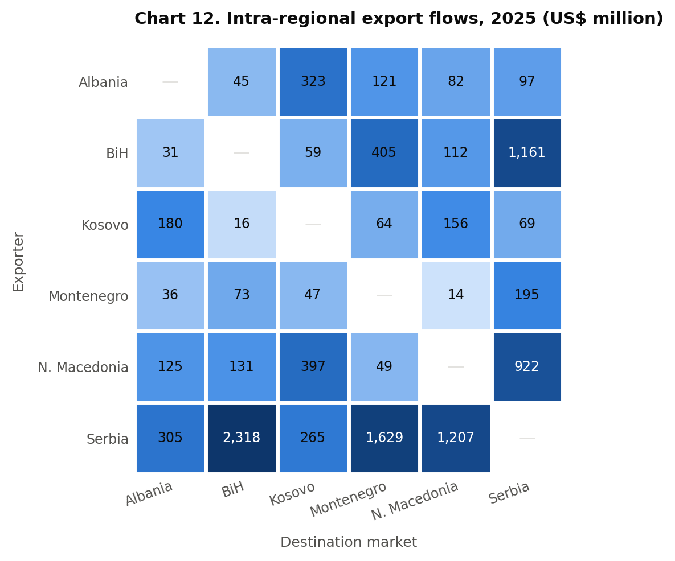
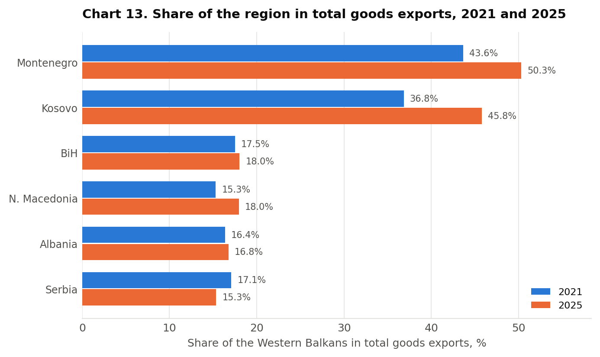
TRADE WITHIN THE REGION
Intra-regional trade flows
8
Notes:
This slide is the handover point. Everything before it is how the six trade with the world; everything after it is what they could trade, and with whom.
Two things to draw out. The region matters very differently to different members — it is a large share of exports for the smaller economies and a small share for Serbia. And the change between 2021 and 2025 is modest in both directions, which is the case for looking at potential rather than at trend: the pattern is not moving much on its own.

Slide 10
EXPORT POTENTIAL
Regional export potential
What each economy could sell on the pattern of world trade, what it actually sells, and where its single largest opportunity lies.
Economy | Potential, US$ bn | Actual, US$ bn | Unrealised (shortfall), US$ bn | Excess over estimate, US$ bn | Realised | Largest market | Its potential, US$ bn | Products towards it | Of those, carrying 80%
Serbia | 37.97 | 33.69 | 20.67 | 16.39 | 88.7% | Germany | 5.40 | 4,019 | 196
Bosnia and Herzegovina | 9.16 | 9.75 | 4.61 | 5.20 | 106.4% | Germany | 1.53 | 2,892 | 127
North Macedonia | 9.38 | 9.67 | 4.38 | 4.67 | 103.1% | Germany | 3.62 | 2,653 | 28
Albania | 3.78 | 2.89 | 2.07 | 1.18 | 76.5% | Italy | 1.30 | 536 | 28
Kosovo | 1.03 | 1.06 | 0.61 | 0.64 | 103.0% | Albania | 0.13 | 1,711 | 34
Montenegro | 0.72 | 0.76 | 0.45 | 0.48 | 105.2% | Serbia | 0.15 | 1,148 | 8
All six | 62.03 | 57.81 | 32.79 | 28.56 | 93.2%
9
Notes:
Shortfall minus excess equals potential minus actual, so the two middle columns close the arithmetic. “Products towards it” counts every six-digit product with an estimate towards that market; the last column is how many of them carry 80 per cent of the value.

Slide 11
EXPORT POTENTIAL · WITHIN THE WESTERN BALKAN SIX
Intra-regional export potential
Each economy against the other five alone: US$ 8.08 billion of estimated potential against US$ 9.86 billion already traded.
Economy | Potential, US$ bn | Actual, US$ bn | Unrealised (shortfall), US$ bn | Excess over estimate, US$ bn | Realised | Largest market in region | Its potential, US$ bn | Products towards it | Of those, carrying 80%
Serbia | 4.16 | 5.20 | 1.19 | 2.22 | 124.7% | BiH | 1.77 | 3,873 | 175
Bosnia and Herzegovina | 1.34 | 1.74 | 0.42 | 0.81 | 129.7% | Serbia | 0.94 | 2,855 | 46
North Macedonia | 1.17 | 1.52 | 0.41 | 0.76 | 129.8% | Serbia | 0.59 | 2,631 | 67
Albania | 0.78 | 0.64 | 0.31 | 0.17 | 82.2% | Kosovo | 0.30 | 529 | 15
Kosovo | 0.34 | 0.42 | 0.11 | 0.20 | 125.3% | Albania | 0.13 | 1,711 | 34
Montenegro | 0.29 | 0.34 | 0.12 | 0.18 | 119.9% | Serbia | 0.15 | 1,148 | 8
All six | 8.08 | 9.86 | 2.56 | 4.34 | 122.0%
How a shortfall survives a surplus. Serbia’s US$ 1.19 billion is the sum of 6,648 product–market pairs below the estimate. Another 10,741 pairs exceed it by US$ 2.22 billion — so on balance Serbia sells US$ 1.03 billion more to its neighbours than the model predicts.
Serbia is the region’s market. It is the largest regional destination for Bosnia and Herzegovina, North Macedonia and Montenegro alike, and five of the six already export more to their neighbours than the model predicts. Albania, at 82% realised, is the exception.
10
Notes:
The regional market is 11% of Serbia's total estimated potential but 40% of Montenegro's and 33% of Kosovo's — the same inverse relationship with size that runs through the whole study. Realisation above 100% means the region already trades with itself more than the pattern of world trade would predict, which is what proximity and CEFTA would lead one to expect.

Slide 12
EXPORT POTENTIAL AND UNREALISED POTENTIAL, BY DESTINATION GROUP
Global market export potential
Not by what the six already sell, but by what the pattern of world trade says they could. The European Union holds US$ 39.60 billion of the region’s potential, the rest of the world US$ 14.35 billion and the other five US$ 8.08 billion.
Economy | Potential — EU | Potential — region | Potential — world | Largest | Unrealised — EU | Unrealised — region | Unrealised — world | Largest
Serbia | 22.94 | 4.16 | 10.87 | EU | 11.69 | 1.19 | 7.79 | EU
Bosnia and Herzegovina | 6.68 | 1.34 | 1.14 | EU | 3.36 | 0.42 | 0.83 | EU
North Macedonia | 6.96 | 1.17 | 1.24 | EU | 2.98 | 0.41 | 1.00 | EU
Albania | 2.45 | 0.78 | 0.54 | EU | 1.31 | 0.31 | 0.45 | EU
Kosovo | 0.35 | 0.34 | 0.35 | EU | 0.24 | 0.11 | 0.26 | World
Montenegro | 0.22 | 0.29 | 0.21 | Region | 0.17 | 0.12 | 0.16 | EU
All six | 39.60 | 8.08 | 14.35 | EU | 19.73 | 2.56 | 10.50 | EU
The region is never where the shortfall is. It holds 13% of the region’s potential but only 8% of the shortfall, because the six already export above the estimate to one another.
Two exceptions. Montenegro’s largest market by potential is the region, not the Union. Kosovo’s largest unmet opportunity lies in the rest of the world — its three groups are almost equal.
11
Notes:
By actual exports the picture differs: the region is the largest partner for Kosovo and Montenegro alike. By potential it is largest only for Montenegro, and by unrealised potential for no one — which is the point of the left-hand note. Kosovo's potential is split almost exactly in thirds: 0.35 to the EU, 0.34 to the region, 0.35 to the rest of the world.

Slide 13
EXPORT POTENTIAL BY SECTORS, ALL SIX ECONOMIES
Export potential by sectors
Ten chapters out of 96 carry 54.8% of the region’s US$ 62.03 billion of estimated potential. The last column counts how many of the six have that chapter among their own ten largest.
# | Ch. | Sector | Potential, US$ m | Share of the region’s | Unrealised, US$ m | Share of the shortfall | Among its own top ten
1 | 85 | Electrical machinery and equipment | 8,229 | 13.3% | 4,172 | 12.7% | 3 of 6
2 | 27 | Mineral fuels and oils | 5,219 | 8.4% | 3,020 | 9.2% | 6 of 6
3 | 84 | Machinery and mechanical appliances | 3,906 | 6.3% | 2,316 | 7.1% | 4 of 6
4 | 87 | Vehicles other than railway | 2,603 | 4.2% | 1,519 | 4.6% | 3 of 6
5 | 39 | Plastics and articles thereof | 2,502 | 4.0% | 1,321 | 4.0% | 4 of 6
6 | 74 | Copper and articles thereof | 2,467 | 4.0% | 1,266 | 3.9% | 1 of 6
7 | 72 | Iron and steel | 2,443 | 3.9% | 1,342 | 4.1% | 5 of 6
8 | 38 | Miscellaneous chemical products | 2,338 | 3.8% | 774 | 2.4% | 1 of 6
9 | 94 | Furniture, bedding, lamps | 2,235 | 3.6% | 1,003 | 3.1% | 4 of 6
10 | 73 | Articles of iron or steel | 2,042 | 3.3% | 889 | 2.7% | 4 of 6
 |  | Top ten, of 96 sectors in all | 33,984 | 54.8% | 17,623 | 53.8%
12
Notes:
Mineral fuels stand near the top for four of the six. The ITC methodology would normally exclude fuels, tobacco, scrap and arms from export promotion analysis; this study leaves them in deliberately, so the team can see the full result and decide what to remove. Chapters that are large for one economy alone — copper for Serbia, miscellaneous chemicals for North Macedonia — still reach the regional top ten, which is why the last column matters.

Slide 14
EXPORT POTENTIAL BY SECTORS
The five largest sectors
Each cell gives the chapter, then its estimated potential and its unrealised potential in US$ million, and what share of that economy’s whole potential it carries.
Serbia (EPI - unrealized potential- % potential) | Bosnia and Herzegovina (EPI - unrealized potential- % potential) | North Macedonia (EPI - unrealized potential- % potential) | Albania (EPI - unrealized potential- % potential) | Kosovo (EPI - unrealized potential- % potential) | Montenegro (EPI - unrealized potential- % potential)
Electrical machinery and equipment 5,538 · 2,822 · 14.6% | Mineral fuels and oils 1,153 · 648 · 12.6% | Miscellaneous chemical products 2,160 · 660 · 23.0% | Footwear 795 · 365 · 21.0% | Furniture, bedding, lamps 142 · 80 · 13.7% | Mineral fuels and oils 262 · 147 · 36.4%
Mineral fuels and oils 2,676 · 1,564 · 7.0% | Electrical machinery and equipment 741 · 453 · 8.1% | Electrical machinery and equipment 1,855 · 829 · 19.8% | Mineral fuels and oils 534 · 353 · 14.1% | Plastics and articles thereof 119 · 66 · 11.5% | Aluminium and articles thereof 70 · 45 · 9.8%
Machinery and mechanical appliances 2,675 · 1,637 · 7.0% | Aluminium and articles thereof 694 · 368 · 7.6% | Machinery and mechanical appliances 628 · 340 · 6.7% | Apparel, not knitted or crocheted 348 · 186 · 9.2% | Mineral fuels and oils 104 · 56 · 10.1% | Ores, slag and ash 59 · 36 · 8.2%
Copper and articles thereof 2,176 · 1,090 · 5.7% | Articles of iron or steel 677 · 247 · 7.4% | Iron and steel 529 · 283 · 5.6% | Salt, sulphur, earths, stone, cement 260 · 135 · 6.9% | Articles of iron or steel 102 · 57 · 9.9% | Wood and articles of wood 53 · 27 · 7.3%
Vehicles other than railway 1,862 · 1,071 · 4.9% | Wood and articles of wood 568 · 241 · 6.2% | Mineral fuels and oils 490 · 252 · 5.2% | Aluminium and articles thereof 198 · 111 · 5.2% | Beverages, spirits and vinegar 83 · 40 · 8.1% | Beverages, spirits and vinegar 44 · 26 · 6.2%
13
Notes:
Mineral fuels appear in four of the six columns, and lead Montenegro’s at 36% of its whole potential. Only two chapters are shared by more than half the columns — mineral fuels and electrical machinery. Everything else is particular to one or two economies, which is the argument against a single regional sector policy.

Slide 15
PRODUCT DIVERSIFICATION INDICATOR, BY ECONOMY
Regional export oportunities
A different question from export potential: not how much more of what they already sell, but what they could sell next. Across the six the indicator comes to US$ 54.54 billion, of which US$ 7.56 billion — 14% — sits in products the economy does not yet export with a comparative advantage.
Economy | Total, US$ bn | Where it has an advantage | Where it has none yet | Share that is new | Of which not exported at all | Products with an advantage | Largest market
Serbia | 38.59 | 35.08 | 3.51 | 9% | 0.31 | 899 | China
Bosnia and Herzegovina | 1.78 | 1.57 | 0.21 | 12% | 0.02 | 678 | Germany
North Macedonia | 9.07 | 6.79 | 2.28 | 25% | 0.28 | 458 | Germany
Albania | 3.33 | 2.31 | 1.02 | 31% | 0.76 | 275 | Italy
Kosovo | 1.50 | 1.07 | 0.43 | 29% | 0.12 | 531 | USA
Montenegro | 0.26 | 0.16 | 0.11 | 41% | 0.05 | 243 | China
All six | 54.54 | 46.98 | 7.56 | 14% | 1.55
Do not rank the economies by this number. The scaling exponent is fitted separately for each economy, so the levels are not one measuring unit. Read the composition within an economy, not its place in the column.
“New” is not the same as “unsold”. No advantage means below the RCA threshold, not absent from the export basket. For Albania 75% of the new part is in products it does not export at all; for Serbia, 9%.
14
Notes:
Scope: mineral fuels are excluded throughout — chapter 27 except petroleum jelly (2712) and electrical energy (2716), which is why that chapter still appears with four products. The rest of Annex V — ores, tobacco, scrap, arms — is left in and marked with an asterisk, so the team can see the amount before deciding.
The indicator is computed for every product, including those the economy already exports with an advantage; the cut to products without an advantage is made here, at reporting. Kosovo is the one economy whose largest market is the United States rather than a European one. Serbia's low share of new products — 9% — is not a weakness: it means its existing basket already covers most of what its capabilities reach.

Slide 16
PRODUCT DIVERSIFICATION INDICATOR BY HS CHAPTER, ALL SIX ECONOMIES
Regional export oportunities by sector
Ten sectors out of 96 carry 54.8% of the region’s US$ 54.54 billion. But the column that matters for diversification is the next one: only US$ 2,985 million of that sits in products no economy yet exports with an advantage.
# | Ch. | Sector | Indicator, US$ m | Share of the region’s | In new products, US$ m | Of it, not exported, US$ m | Share that is new | In how many of the six
1 | 85 | Electrical machinery and equipment | 5,228 | 9.6% | 658 | 100 | 13% | 6 of 6
2 | 26 | Ores, slag and ash | 4,440 | 8.1% | 212 | 204 | 5% | 4 of 6
3 | 10 | Cereals | 3,694 | 6.8% | 96 | 14 | 3% | 1 of 6
4 | 94 | Furniture, bedding, lamps | 3,225 | 5.9% | 181 | 6 | 6% | 5 of 6
5 | 74 | Copper and articles thereof | 2,796 | 5.1% | 110 | 55 | 4% | 1 of 6
6 | 27 | Mineral fuels and oils | 2,397 | 4.4% | 1 | 0 | 0% | 5 of 6
7 | 87 | Vehicles other than railway | 2,337 | 4.3% | 605 | 56 | 26% | 5 of 6
8 | 39 | Plastics and articles thereof | 2,155 | 4.0% | 313 | 16 | 15% | 4 of 6
9 | 72 | Iron and steel | 2,023 | 3.7% | 356 | 110 | 18% | 3 of 6
10 | 84 | Machinery and mechanical appliances | 1,594 | 2.9% | 454 | 37 | 29% | 2 of 6
 |  | Top ten, of 96 chapters in all | 29,890 | 54.8% | 2,985 | 598 | 10%
15
Notes:
Scope: mineral fuels are excluded throughout — chapter 27 except petroleum jelly (2712) and electrical energy (2716), which is why that chapter still appears with four products. The rest of Annex V — ores, tobacco, scrap, arms — is left in and marked with an asterisk, so the team can see the amount before deciding.
The ranking by level is dominated by what the region already sells. The diversification reading is a different list: by amount in products no economy yet exports competitively it runs Electrical machinery and equipment (US$ 658 m), Vehicles other than railway (US$ 605 m), Machinery and mechanical appliances (US$ 454 m). The highest share of new products among the sizeable chapters is Essential oils, perfumery, cosmetics, at 94% of a US$ 137 million chapter. Ores and mineral fuels are large in level and almost nil in new products, which is the clearest argument for the Annex V exclusions — and in ores what little there is is almost all unexported: US$ 204 million of it. Summing across economies is arithmetic only — the per-economy scaling means the total is not a single measuring unit.

Slide 17
PRODUCT DIVERSIFICATION INDICATOR BY SECTOR
Five largest sectors
Each cell gives the chapter, then the indicator and the part of it in products with no advantage yet, in US$ million, and what share of that economy’s whole indicator the chapter carries. Levels are not comparable across columns.
Serbia | Bosnia and Herzegovina | North Macedonia | Albania | Kosovo | Montenegro
Electrical machinery and equipment 3,694 · 334 · 9.6% | Furniture, bedding, lamps 230 · 4 · 12.9% | Electrical machinery and equipment 1,127 · 124 · 12.4% | Apparel, knitted or crocheted 604 · 26 · 18.1% | Furniture, bedding, lamps 177 · 10 · 11.8% | Ores, slag and ash 37 · 5 · 14.0%
Cereals 3,546 · 3 · 9.2% | Electrical machinery and equipment 163 · 37 · 9.1% | Iron and steel 1,039 · 98 · 11.4% | Apparel, not knitted or crocheted 490 · 49 · 14.7% | Plastics and articles thereof 136 · 8 · 9.1% | Beverages, spirits and vinegar 22 · 2 · 8.4%
Ores, slag and ash * 3,515 · 122 · 9.1% | Mineral fuels and oils * 137 · 0 · 7.7% | Ores, slag and ash * 693 · 17 · 7.6% | Footwear 326 · 56 · 9.8% | Articles of iron or steel 78 · 6 · 5.2% | Pharmaceutical products 16 · 1 · 6.1%
Copper and articles thereof 2,607 · 46 · 6.8% | Footwear 120 · 1 · 6.7% | Apparel, not knitted or crocheted 561 · 40 · 6.2% | Electrical machinery and equipment 170 · 102 · 5.1% | Beverages, spirits and vinegar 75 · 4 · 5.0% | Mineral fuels and oils * 12 · 0 · 4.6%
Furniture, bedding, lamps 2,232 · 49 · 5.8% | Plastics and articles thereof 115 · 6 · 6.5% | Furniture, bedding, lamps 462 · 94 · 5.1% | Ores, slag and ash * 128 · 62 · 3.9% | Electrical machinery and equipment 66 · 55 · 4.4% | Aluminium and articles thereof 12 · 2 · 4.4%
16
Notes:
Scope: mineral fuels are excluded throughout — chapter 27 except petroleum jelly (2712) and electrical energy (2716), which is why that chapter still appears with four products. The rest of Annex V — ores, tobacco, scrap, arms — is left in and marked with an asterisk, so the team can see the amount before deciding.
Compare this with the same matrix for export potential: there, mineral fuels appeared in four of the six columns. Here the recurring chapter is electrical machinery, and ores appear wherever an economy has a mine. The second number in each cell is the one to watch — in several of the largest chapters it is a small fraction of the first, meaning the chapter is large because the economy already sells it, not because it could move into it.

Slide 18
REGIONAL VALUE CHAINS ASESSMENT
Regional value chain perspective
Every HS4 group that the input–output matrix shows as producing something from something else is a candidate — 400 of them. 120 survive the test of being regional, and they carry 84% of the candidates’ export potential. 30 of those are set out chain by chain.
Stage | Chains | Share of the chains | HS6 outputs | HS6 outputs and main inputs | Potential, US$ bn | Share of the potential
All candidate chains | 400 | 100% | 1,895 | 2,974 | 17.17 | 100.0%
Regional chains | 120 | 30% | 827 | 1,559 | 14.38 | 83.8%
Set out chain by chain | 30 | 8% | 242 | 721 | 10.90 | 63.5%
What the test is. A chain counts as regional when at least two of the six can make its finished good and at least two can supply its main inputs — each on comparative advantage of 1 or more and estimated potential of at least US$ 500,000. The output side does the work: on inputs alone 374 of the 400 would pass.
Narrowing concentrates, it does not discard. The 30 chains set out in full are a quarter of the regional ones but carry 76% of their potential, and they come from 9 of the 11 sectors. The ones left out are small, not unrepresentative.
17
Notes:
The three rows answer three different questions. The first is the universe the matrix offers: 400 HS4 chains built from 2,974 products. The second is what the region can actually participate in on both sides. The third is what the study documents individually.
Two numbers are worth pointing at. The chain count falls by 70% from the first row to the second, but the potential falls by only 16% — the chains that fail the test are the small ones. And the product count falls faster than the chain count at the last step, from 1,559 to 721, because the documented chains are the bigger and more concentrated ones.
Document 19 works with 523 of those 721 products rather than all of them: the rest have no position on the proximity map, so no distance to any other product can be computed for them. It is a subset, not a different count.

Slide 19
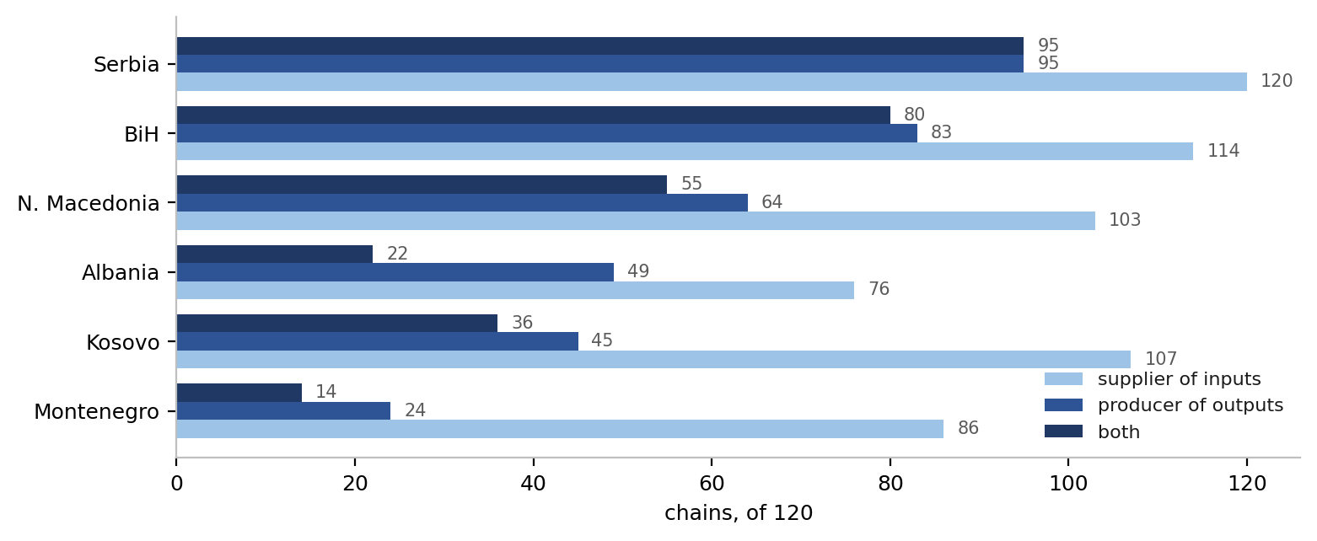
THE VALUE CHAINS
Identified regional value chains with largest perspectives
120
US$ 14.38 bn
523
chains qualify, out of 400 candidates
of export potential in their outputs
products in the thirty set out in full
18
Notes:
Serbia takes part in all 120 chains as a supplier and produces the finished good in 95. Montenegro supplies into 86 and produces in 24. That asymmetry is the subject of the next three slides.

Slide 20
VALUE CHAINS · SET OUT CHAIN BY CHAIN
The thirty chains
Ranked by the export potential of the finished good. Together they carry US$ 10.90 billion — 76% of what the 120 regional chains carry — and they run from electric motors to chocolate, across 9 of the 11 sectors.
# | HS4 | Chain | US$ m |  | # | HS4 | Chain | US$ m |  | # | HS4 | Chain | US$ m
1 | 8501 | Electric motors and generators | 1,058 |  | 11 | 6115 | Hosiery, tights and socks | 380 |  | 21 | 4818 | Paper articles | 204
2 | 3004 | Medicaments | 929 |  | 12 | 6203 | Men's suits, jackets and trousers, woven | 358 |  | 22 | 8702 | Buses and coaches, ten persons or more | 201
3 | 3402 | Washing and cleaning preparations | 692 |  | 13 | 9401 | Seats | 331 |  | 23 | 2203 | Beer | 194
4 | 2202 | Non-alcoholic beverages | 618 |  | 14 | 2106 | Food preparations not elsewhere specified | 308 |  | 24 | 8504 | Transformers and static converters | 175
5 | 8703 | Passenger cars | 550 |  | 15 | 8413 | Pumps for liquids | 295 |  | 25 | 8419 | Heat exchange and process machinery | 174
6 | 8421 | Centrifuges and filtering machinery | 544 |  | 16 | 8418 | Refrigerators and freezers | 283 |  | 26 | 4205 | Leather articles | 172
7 | 9403 | Furniture | 519 |  | 17 | 2005 | Vegetables preserved other than in vinegar | 249 |  | 27 | 6204 | Women's suits, dresses and trousers, woven | 157
8 | 2402 | Cigarettes and cigars | 510 |  | 18 | 8414 | Air pumps, compressors and fans | 225 |  | 28 | 6109 | T-shirts, singlets and other vests | 151
9 | 1905 | Bread, biscuits and bakers' wares | 481 |  | 19 | 1512 | Vegetable oils | 221 |  | 29 | 2105 | Ice cream and other edible ice | 144
10 | 6403 | Footwear with leather uppers | 422 |  | 20 | 9404 | Mattresses and bedding | 220 |  | 30 | 1806 | Chocolate and cocoa preparations | 134
19
Notes:
The list is worth reading for its shape rather than its order. 9 of the thirty are food and beverage and 5 are machinery — the two sectors that between them define the region's two kinds of chain. Food chains are short, local and perishable; machinery chains are long, export-facing and assembled from inputs the region mostly does not make.
The top of the list is not where the interesting cases are. Electric motors, medicaments and cleaning preparations are large because the region already sells them. The cases to talk about are further down — buses at US$ 201 million, where two economies build and all six supply, and beer at US$ 194 million, where the chain is almost entirely inside the region already.

Slide 21
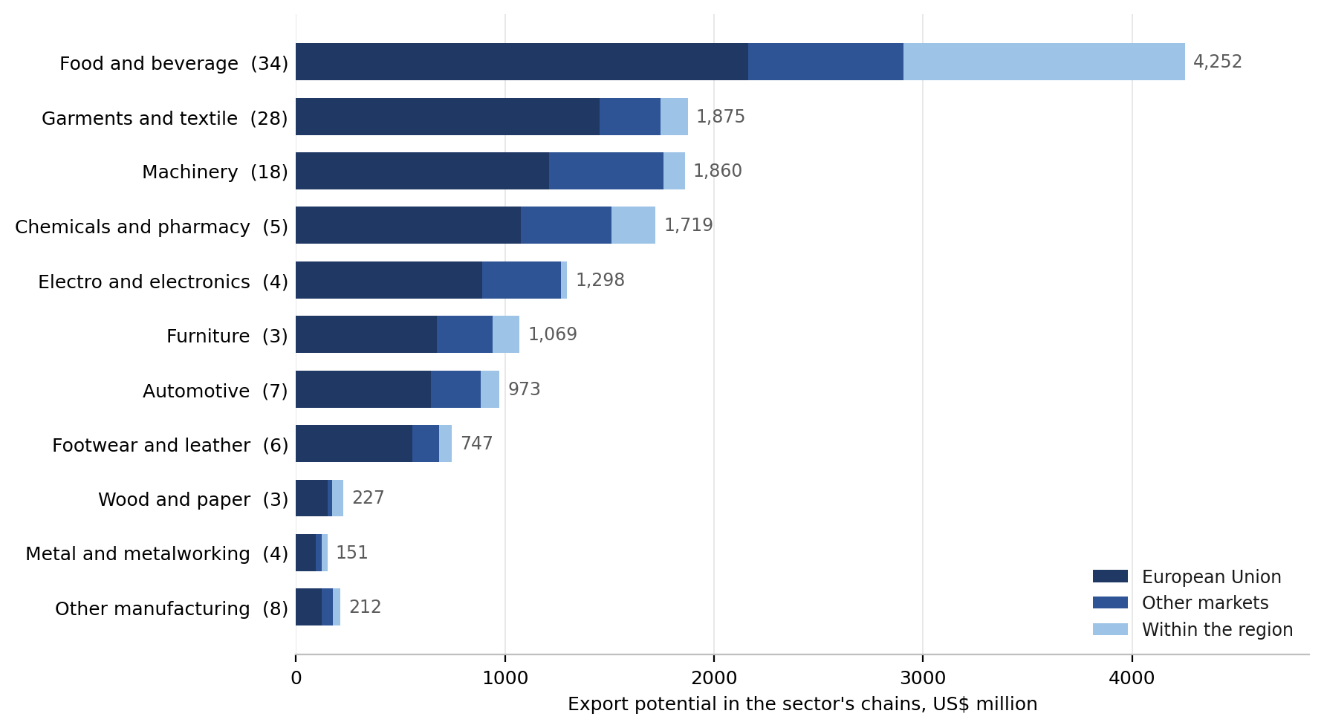
THE VALUE CHAINS BY SECTOR
Two different value chains
What separates them is one number: how many main inputs a chain has. By that measure the eleven sectors fall into two groups with nothing in between — and the two groups carry almost the same potential but sell it in different places.
Short chains — 19.9 main inputs each
Food and beverage, Chemicals and pharmacy, Wood and paper, Footwear and leather and Other manufacturing. 56 chains, US$ 7.16 billion, and 24% of the potential sold to the neighbours.
Long chains — 70.8 main inputs each
Metal and metalworking, Garments and textile, Automotive, Furniture, Machinery and Electro and electronics. 64 chains, US$ 7.23 billion — almost the same, but only 7% stays in the region against 69% to the European Union.
The length is the variable, not the label
Across the eleven sectors the correlation between main inputs per chain and the share staying in the region is -0.74. Garments sits with machinery, not with food.
20
Notes:
The slide used to say there are two kinds of chain and describe them in words. This version gives the measure.
Sorted by main inputs per chain, the eleven sectors run 12.5, 28.0, 30.0, 30.2, 34.6 — then jump to 53.2, 62.0, 76.0, 79.3, 81.3, 87.2. The 18.6-input gap in the middle is the largest anywhere in the series, which is why a two-group reading is defensible rather than imposed. If that gap ever closes the data script refuses to produce the split.
The point to make out loud: the two groups carry almost exactly the same potential — US$ 7.16 against US$ 7.23 billion — so this is not a story about one half of the economy being small. It is a story about where the two halves sell. Short chains keep 24% of their potential inside the region; long chains keep 7%. Perishability and transport cost explain the first; the second is that a long chain needs inputs the region cannot supply, so it reaches outside for them and sells outside as well.
Garments is the case that proves the title. It is light manufacturing by label but has 62 main inputs per chain and keeps 7 per cent in the region — it belongs with machinery.

Slide 22
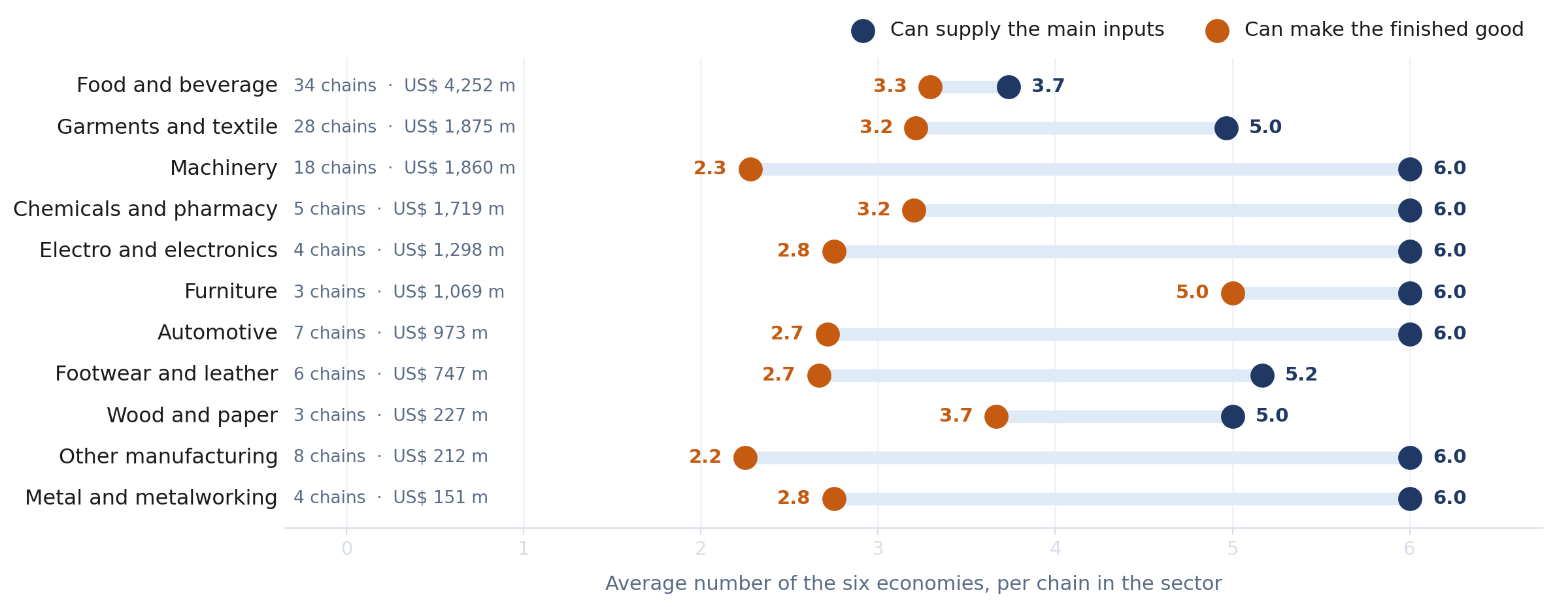
VALUE CHAINS · THE CENTRAL FINDING
Regional value chains production capabilities
In seven of the eleven sectors all six economies can competitively supply the main inputs into every single chain. The finished good is another matter: across those same chains only two or three can make it. Each line below is that gap.
Widest gap: Other manufacturing, 3.8 of six. Narrowest: Food and beverage, 0.4 — short, perishable chains that stay close to home.
21
Notes:
This is the slide the whole value-chain section turns on. The inputs side is nearly saturated — in machinery, chemicals, electro, furniture, automotive, metalworking and the residual manufacturing sector, every one of the six can supply every chain. The output side is not: machinery averages 2.3 of six, the residual sector 2.2. Two sectors break the pattern and both are worth naming. Furniture is the only place where the two numbers nearly meet at the top — five of six can build the finished good. Food and beverage meets at the bottom instead: 3.7 suppliers against 3.3 producers, because perishability keeps those chains short and local rather than because the region is strong in them. The policy reading is that input capability is not the binding constraint anywhere; assembly capability is.

