Slide 1

Strengthening the supply chain for the European battery industry – a prerequisite for Europe’s competitiveness
Ilka von Dalwigk, EBA Policy Manager

Slide 2

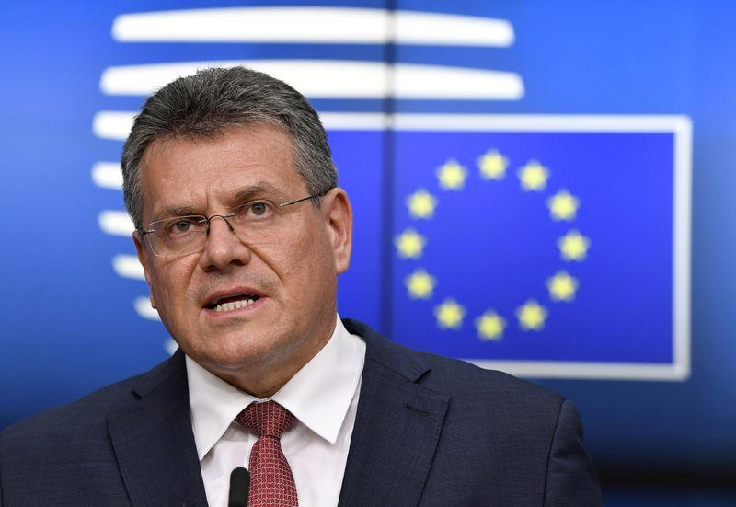



EBA – an industrial policy success story supported by European Decision Makers
EBA250 Mission
To enable and build the resilient, competitive and sustainable EU battery value chain worth €250bn/a by 2025
EIT InnoEnergy
Mandated by the European Commission to drive forward the activities of the EBA250
Maroš Šefčovič, EVP of the European Commission
“The lack of a domestic, European cell manufacturing bases jeopardizes the position of EU customers because of the security of the supply chain, increased costs due to transportation, time delays, weaker quality control or limitations on the design. So, we need to act fast – and collectively- to overcome this competitive disadvantage […] ”
Collaboration with Stakeholders
Work closely with industry & decision makers at EU and Member State level
Value Chain
800+ dynamic industrial members, inclusive and comprehensive ecosystem
Notes:
Global production capacity in 2016 – 28 GWh – and forecasted to 2020: 174 GWH
7% EU GDP corresponds to 1 trillion Euros
14 million direct and indirect jobs
17.300 companies
30% of EU’s total R&D spending

Slide 3
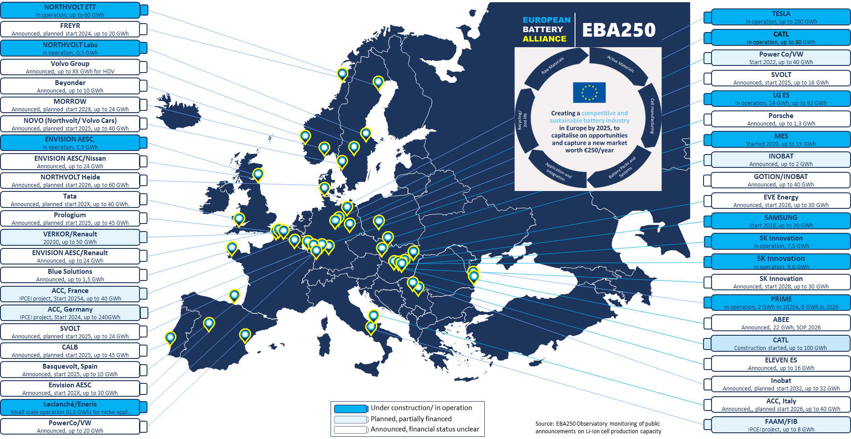
From zero production to 1300GWh of announced cell production capacity

Slide 4
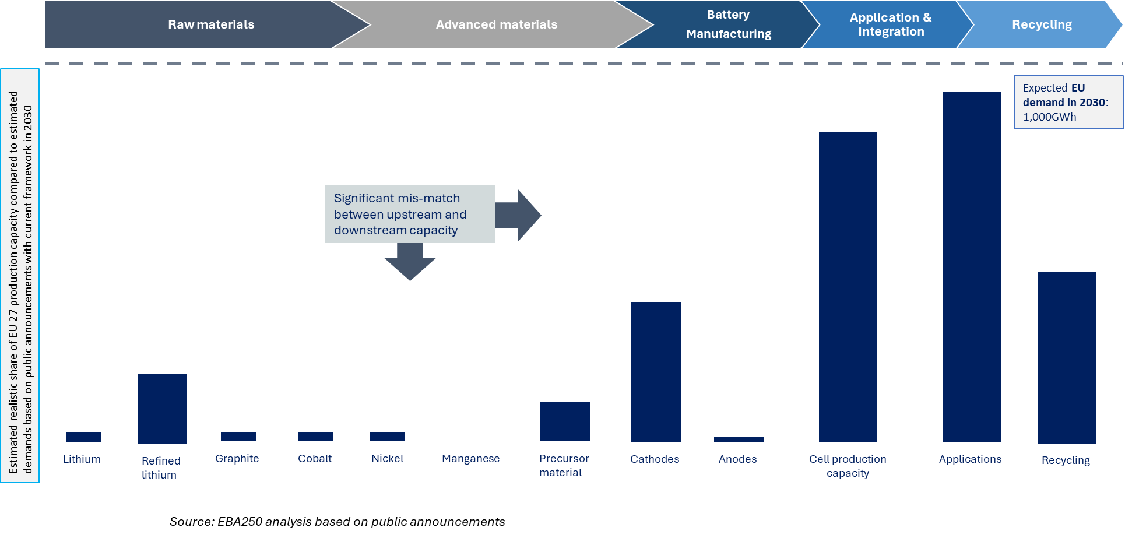
UP-STREAM ACTIVITY TO MEET EUROPE’S TARGETS LAGS SIGNIFICANTLY BEHIND DOWNSTREAM INVESTMENT

Slide 5
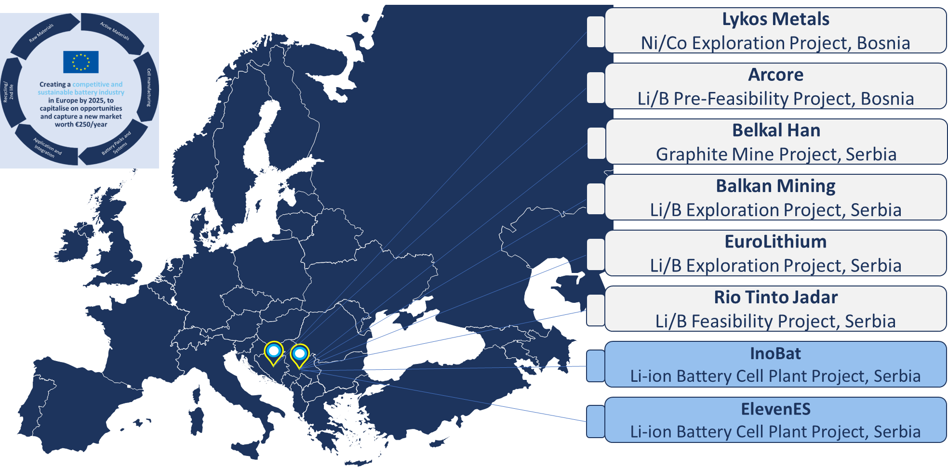
Can the Western Balkans contribute to filling the battery value chain gaps in Europe?

Slide 6










Opportunities to develop strong domestic ecosystems to support of the European battery value chain
Raw materials
Advanced materials
Battery
Manufacturing
Application & Integration
Recycling
Industry
Cross-sectorial
University of Belgrade

Slide 7
Building on sustainability from the start - Access to sustainable raw materials is KEY to develop the battery industry in Europe!!!
Production of raw and processed materials for battery production are the most energy intensive steps in battery production
Sustainable, ethical and transparent supply of battery raw materials important in the shift to electrification
Opportunities for Western Balkans
Domestic production and International cooperation: Increased demand will lead to supply risks and bottlenecks along the supply chain, also related to the concentration of battery material production in few countries – unless we boost domestic production and international partnerships
Transparent and Sustainable Supply Chains: Focus on primary raw material with low carbon footprint sourced from Europe- or ensure sourcing with same high standards from outside Europe
Build on existing capabilities and strength: Metal-processing, automotive and machinery are strategic sectors necessary to build a resilient European battery value chain. Strengthening skills and targeting strategic investment in these sectors important

Slide 8
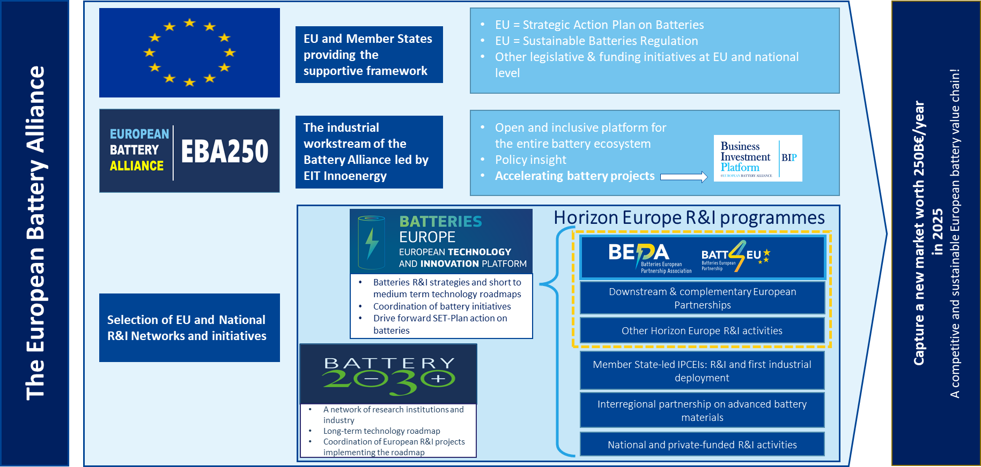

Overview of the European battery ecosystem

Slide 9

www.eba250.com
Get in touch!
We look forward to hearing from you
ilka.vondalwigk@innoenergy.com

